Slide 1

Estimation Techniques
“One accurate measurement is worth a thousand expert opinions.”
- Grace Murray Hopper

Slide 2

What is Software Test Estimation?
Test estimation is a management activity which approximates how long a Task would take to complete.
Estimating effort for the test is one of the major and important tasks in Test Management.

Slide 3




What to Estimate?
Resource
Time
Human Skills
Cost

Slide 4

How to estimate?
List of Software Test Estimation Techniques
Work Breakdown Structure
3-Point Software Testing Estimation Technique
Wideband Delphi technique
Function Point/Testing Point Analysis
Use – Case Point Method

Slide 5
Steps Involved In Estimation
Identify Scope
State Assumptions
Assess the Tasks Involved
Estimate the effort for each task
Calculate Total Effort
Work out Elapsed time /critical path
yes
no
Finish and present the Estimate
Is the total reasonable?
Reassess tasks and /or effort

Slide 6


Effort Estimation For Tasks
1)Functional Point Method
2)Three Point Estimation

Slide 7



1)Functional Point Method
Based on the complex of software functions, the Test Manger has to give enough weightage to each functional point.
Group | Weightage
Complex | 5
Medium | 3
Simple | 1

Slide 8





Lets detemine the complexity of each method
SLNO | Module Name | Weightage
1 | New Account | 5
2 | Balance Enquiry | 3
3 | Fund Transfer | 5
4 | Delete Account | 1
5 | Deposit | 3
6 | Withdrawal | 3
7 | Exit | 1

Slide 9

Estimate duration for the task
After classifying the complexity of the function points, you have to estimate the duration to test them. Duration means how much time needs to finish the task.
Total Effort: The effort to completely test all the functions of the application
Total Function Points: Total modules of the application
Estimate defined per Function Points**: The average effort to complete one function points. This value depends on the productivity of the member who will take in charge this task.
**Assume estimated defined per Function Points of 5 hours/points.

Slide 10

Estimate the total effort to test all the features
 | Weightage | #of Function Points | Total
Complex | 5 | 2 | 10
Medium | 3 | 3 | 9
Simple | 1 | 2 | 2
Function Total Points |  |  | 21
Estimate define per point |  |  | 5
Total estimated Efforts |  |  | 105

Slide 11









Estimate the cost for the tasks
How much does it cost?
Average team salary =
Time to “Create Test Specs” =.
Cost for the task is * =

Slide 12
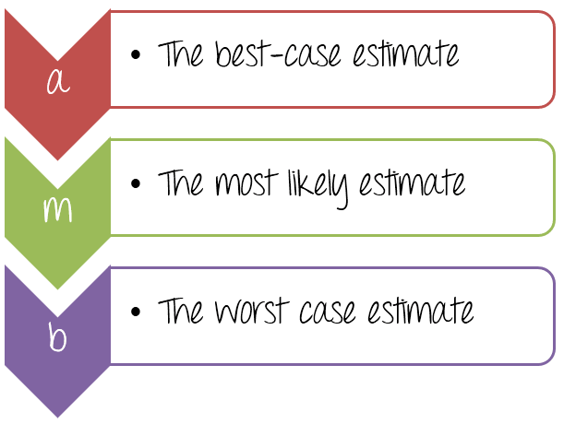
2) Three Point Estimation
The simplicity of the Three-point estimation makes it a very useful tool for a Project Manager that who wants to estimate.
= 80
=105
=130

Slide 13


The effort to complete the task can be calculated using double-triangular distribution formula as follows-
E = ( a + ( 4 * m + b ) / 6
E = ( 80 + ( 4 * 105 + 130 ) / 6
E = 105 ( man-hours)
SD = ( b – a ) / 6
SD = ( 130 – 80 ) / 6
SD= 8.33 ( man-hours )
To complete the task “Create the test specification” you need 105 ± 8.33 Man-hour (105 to 113.33 man-hour)

Slide 14


Validate the estimation
Once you create an aggregate estimate for all the tasks, you need to forward it to the management board, who will review and approve it.
The management board will review and discuss your estimation plan with you. You may explain them your estimation logically and reasonably so that they can approve your estimation plan.

Slide 15

Importance Of Estimate
Causes of Software Runaways
  Project objectives not fully specified(51%)
  Bad planning and Estimating(48%)
  Technology new to the organization(45%)
  Inadequate or no project management methodology (42%)
  Insufficient senior staff on the team(42%)
  Poor performance by suppliers of hardware / Software (42%)

Slide 16
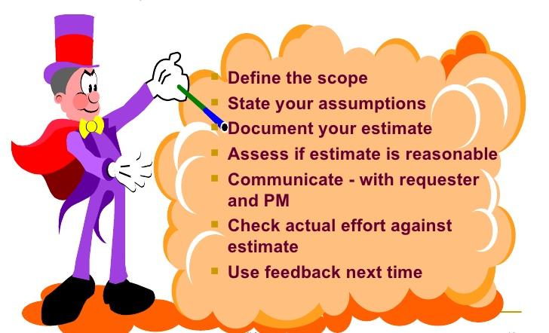
Conclusion

Slide 17


